Slide 1
Russell Conjugation
Pragya MiSHRA
SPONSOR: Prof. SHLOMO ArGAMON, Dept Chair, COMPUTER SCIENCE
ILLINOIS institute of technology

Slide 2
Background
Use of subtly emotive language can bias interpretation of otherwise objective and accurate characterizations of people and events.
Bertrand Russell memorably encapsulated the idea in pseudo-conjugations such as:
I am firm, you are obstinate, he is a pig-headed fool.
I am righteously indignant, you are annoyed, he is making a fuss over nothing.
I have reconsidered the matter, you have changed your mind, he has gone back on his word.
Here, pairs of words such as ‘firm’, ‘obstinate’ and ‘pigheaded’ are known as Russell or Emotive Conjugates of each other.

Slide 3
Objective
Long term goal:
Investigate extent to which Russell conjugations are used to bias rhetoric
Develop tools to make readers aware of such rhetorical tricks
Study how such tools affect readers’ perceptions of bias and evaluation of information
Current project’s goal:
Identify source of polarization in a rhetoric, i.e., emotive words
Explore techniques to identify and present Russell Conjugates of these emotive words as an option to the user.

Slide 4
Deliverables
Front-end: A web app that takes a URL as an input and provides options for alternate texts
Back-end: Potential approach to identifying Russell Conjugates
2 Months; 1 developer, 1 sponsor/academic advisor
Programming Language: Python
Notes:
No computational work on Russell conjugation done before – so exploratory work was the key part

Slide 5
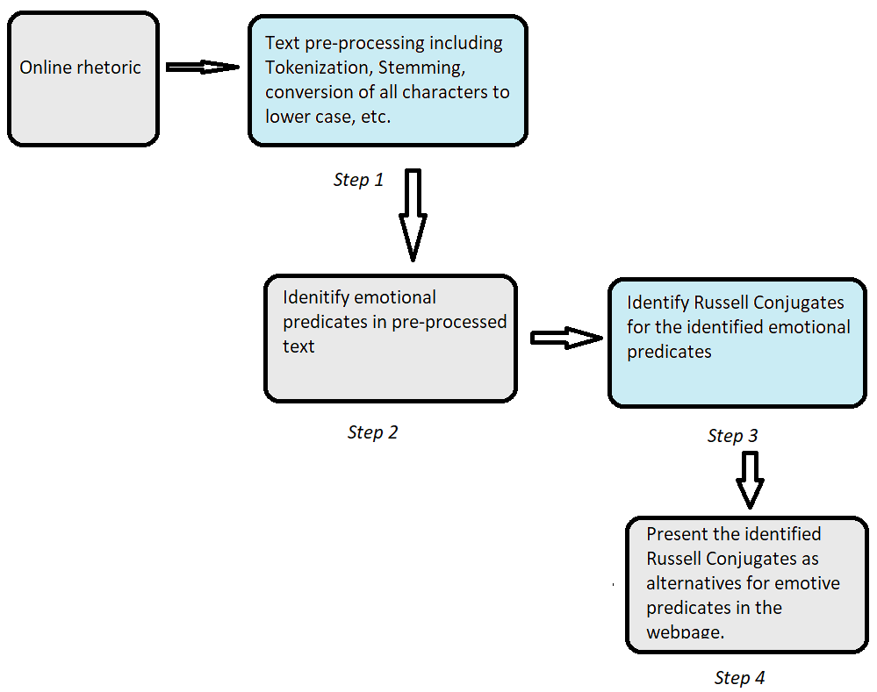
Workflow summary
Agile Development
Notes:
WSD= Word Sense Disambiguation. Three approaches and their variants were studied.

Slide 6

Online rhetoric
Web scraping using Python : BeautifulSoup, Requests
For the current scope, structure limited to CNN.com

Slide 7

Step 1: Text pre-processing
Criteria for 2 words to be Russell Conjugates:
Have the same part of speech
Have approximately the same denotational meaning,
Have differing emotional values, and
Are used in the same or similar textual contexts.
Thus, pre-processing includes:
Normalization – word stripping, removing non-alphabetical characters, case uniformity, etc.
Tokenizing
Stemming
Lemmatization

Slide 8

Step 2: Identifying emotional predicates
Focus on adjectives and verbs
Scope can be later increased to nouns, adverbs and variants
Normal and contextual POS tagging was done to obtain these
Sentiment lexicons were used for initial research – lacks comprehensiveness, heavily biased

Slide 9
Step 3: Identify Russell Conjugates
Three approaches:
Dictionary-based Word Sense Disambiguation (WSD)
Probabilistic Language Model – N grams
Word Embeddings – Word2vec
Notes:
Three Methods were explored

Slide 10
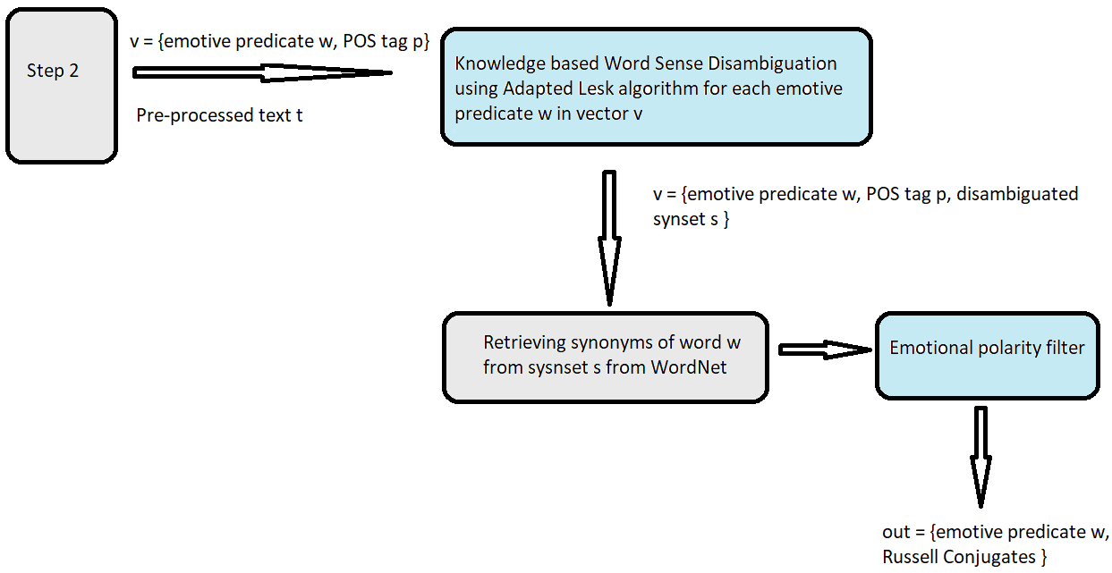
Approach 1: Dictionary based WSD

Slide 11
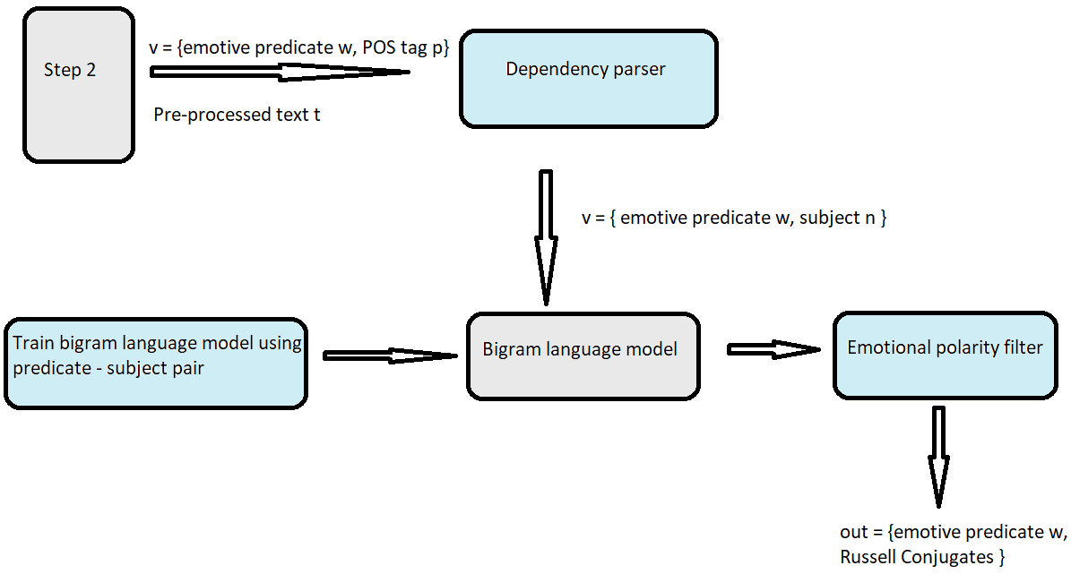
Approach 2: N grams

Slide 12
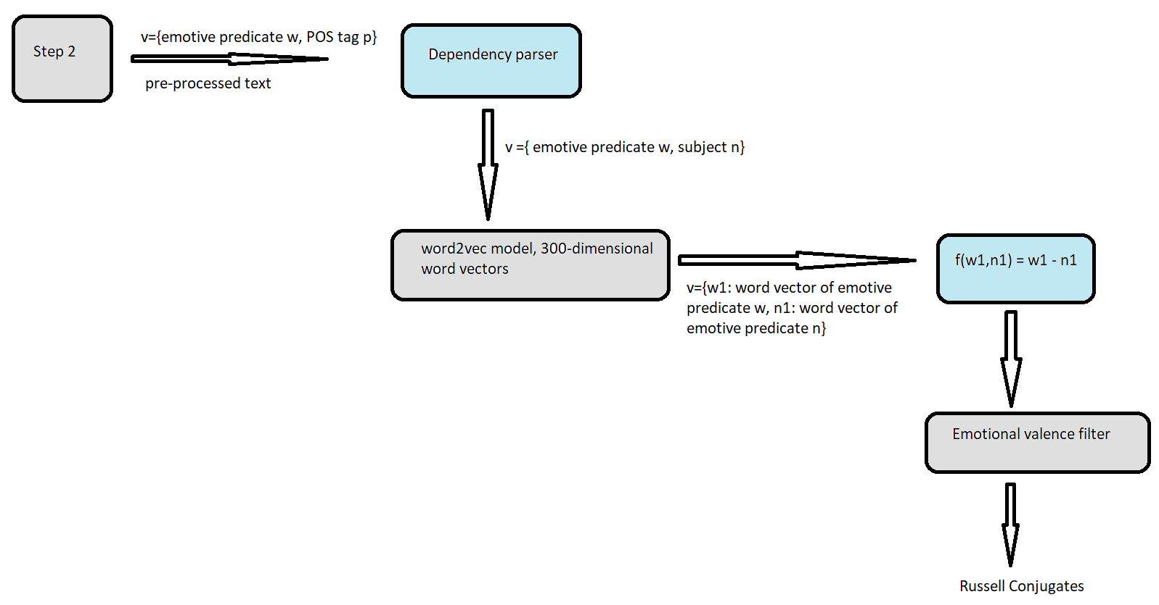
Approach 3: Word Embeddings

Slide 13
Evaluation of approaches
Evaluation metric: Precision
Two levels of testing were done
Developer testing:
About 100-150 webpages were used for this evaluation
Collective precision for all the web pages combined was calculated
User testing:
3 focus group (size 5-10) of students were used for the testing
High level question on google forms were used to evaluate the judgement of three approaches
Collective precision from all groups were noted
Winner: Word Embeddings (approach 3)
Notes:
Precision: Of the number of conjugates presented, how many were correct?
, depended on Judging whether the alternate word presented were correct or incorrect human judgement. Thus 2 levels of testing

Slide 14

Step 4: Result presentation
The Russell conjugates identified in the earlier step are now populated back on the web app
For current scope, title of the CNN.com articles are used for analysis
This can be expanded to other texts and page structures
Notes:
Populated as options on the drop-down box

Slide 15

NEXT STEPS:
Deep Dive into word embeddings

Slide 16
Deliverables:
Russell Conjugates Dataset :
Created dataset with total 4756 observations.
Number of Russell Conjugate observations = 352
Number of Non-Russell Conjugate observations= 4404
Automatic identification or generation of Russell Conjugates:
Classifier for identifying pair of words as Russell Conjugates
Notes:
WSD= Word Sense Disambiguation. Three approaches and their variants were studied.

Slide 17
Approach - classifier for automatic identification
Classifier 1:
Used for denotational and contextual grouping
Best results obtained using SVM with radial basis kernel, with gamma=0.3.
Other approaches used were Naïve Bayes, Logistic and Linear SVM
Data prep:
Conversion of all words into their word vectors
Calculating difference of the 2 word vectors in each observation
Dataset creation
Contextually and denotationally similar pairs of words
Classifier 2:
Used for filtering out synonyms (emotional valence difference=0) from others.
Best results obtained using SVM with radial basis kernel, with gamma=0.75.
Other approaches used were Naïve Bayes, Logistic, random forest, and Linear SVM
Russell Conjugate pairs
Timeline: 3 months

Slide 18
Classifier 1 methods and result comparison
Results:
Classifier 2 methods and result comparison
 | Models
 | Logistic | Naïve Bayes | SVM-Linear | SVM-RBF
Accuracy | 0.473881029 | 0.892365379 | 0.559169891 | 0.940789662
F-1 | 0.326444474 | 0.685981865 | 0.361925812 | 0.791424944
Precision | 0.432427529 | 0.664648373 | 0.444875423 | 0.926099522
Recall | 0.275879996 | 0.722130443 | 0.342845562 | 0.741192416
 | Models
 | Naïve Bayes | SVM-Linear | GradientBoosting | RandomForest | SVM - RBF
Accuracy | 0.646948718 | 0.526809955 | 0.569769231 | 0.58741629 | 0.706348265
F-1 | 0.640339407 | 0.435208772 | 0.541194063 | 0.535540457 | 0.601182652
Precision | 0.655236225 | 0.425913644 | 0.547334208 | 0.551725413 | 0.608676886
Recall | 0.642592114 | 0.475737628 | 0.54043166 | 0.536755369 | 0.600713012
Pipeline Testing: Test performed on test9_20.csv
Accuracy: 0.818
F-1 score: 0.733
Precision: 0.733
Recall: 0.733

Slide 19
THANK YOU!

